Slide 1
Transformed Images

Slide 2
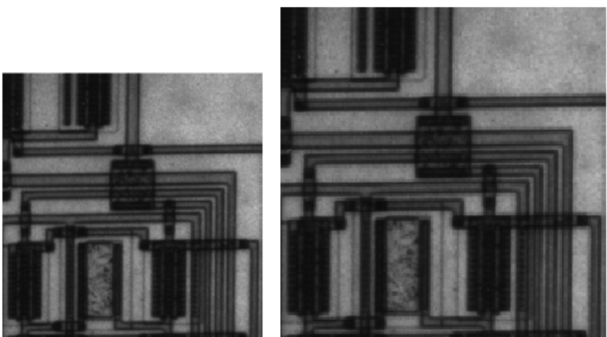
Resize an Image
I = imread('circuit.tif');
J = imresize(I,1.25);
imshow(I)
figure, imshow(J)
This example creates an output image with 100 rows and 150 columns.
  I = imread('circuit.tif');
  J = imresize(I,[100 150]);
  imshow(I)
  figure, imshow(J)
Y = imresize(X,[100 150],'bilinear')

Slide 3
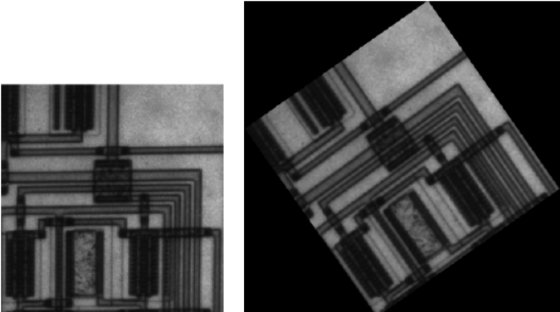
Rotating an Image
I = imread('circuit.tif');
J = imrotate(I,35,'bilinear');
imshow(I)
figure, imshow(J)

Slide 4
Cropping an Image
I = imread('circuit.tif')
J = imcrop(I);
imcrop displays the image in a figure window and waits for you to draw the crop rectangle on the image.
I = imread('circuit.tif');
J = imcrop(I,[60 40 100 90]);

Slide 5
Apply Linear Conformal Transform
Linear conformal transformations may include a rotation, a scaling, and a translation.
Shapes and angles are preserved.
Parallel lines remain parallel.
Straight lines remain straight.
[u v] = [ x y 1] T
  T is a 3-by-2 matrix that depends on four parameters.
% Try varying these 4 parameters.
scale = 1.2; % scale factor
angle = 40*pi/180; % rotation angle
tx = 0; % x translation
ty = 0; % y translation
sc = scale*cos(angle); ss = scale*sin(angle);
T = [ sc -ss;
ss sc;
tx ty];

Slide 6

Since linear conformal transformations are a subset of affine transformations;
  we create a TFORM struct using:
t_lc = maketform('affine',T);
I = checkerboard(10,2);
I_linearconformal = imtransform(I,t_lc,'FillValues',.3);
subplot(332)
imshow(I_linearconformal);
title('linear conformal')

Slide 7
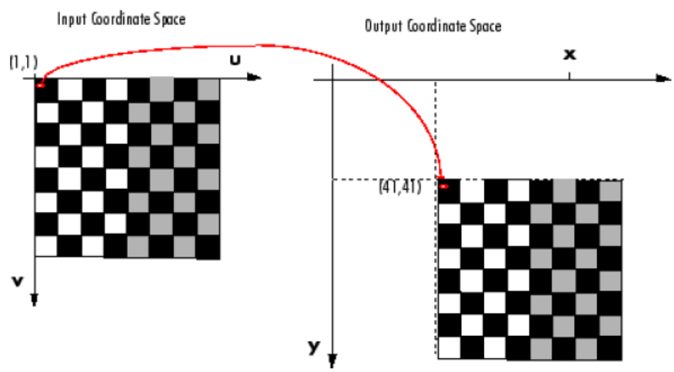
cb = checkerboard;
imshow(cb)
xform = [ 1 0 0
0 1 0
40 40 1 ]
tform_translate = maketform('affine',xform);
[cb_trans xdata ydata]= imtransform(cb, tform_translate);
In the xform matrix, xform(3,1) specifies the number of pixels to shift the image in the horizontal direction and
xform(3,2) specifies the number of pixels to shift the image in the vertical direction
xdata and ydata arguments return the location of the output image in output coordinate space.
  xdata contains the x-coordinates of the pixels at the corners of the output image.
  ydata contains the y-coordinates of these same pixels.

Slide 8


When viewing the transformed image, especially for a translation operation, it might appear that the transformation had no effect.
The reason that no change is apparent in the visualization is because imtransform sizes the output image to be just large enough to contain the entire transformed image
The following example uses two of these optional input parameters, XData and YData, to specify how much of the output coordinate space to include in the output image. The example sets the XData and YData to include the origin of the original image and be large enough to contain the entire translated image.
cb_trans2 = imtransform(cb, tform_translate, 'XData',[1 (size(cb,2)+xform(3,1))], 'YData', [1 (size(cb,1)+xform(3,2))]);
figure, imshow(cb_trans2)
cb_trans2 = imtransform(cb, tform_translate, 'XData',[1 (size(cb,2)+xform(3,1))], 'YData', [1 (size(cb,1)+xform(3,2))], 'FillValues', .7);

Slide 9
affine transformation
In an affine transformation, the x and y dimensions can be scaled or sheared independently and there may be a translation.
Shapes and angles may not preserved
Parallel lines remain parallel.
Straight lines remain straight.
Linear conformal transformations are a subset of affine transformations.
[u v] = [ x y 1] T.
  T is a 3-by-2 matrix, where all six elements can be different.

Slide 10

T = [1 0.1;
1 1;
0 0];
t_aff = maketform('affine',T);
I = checkerboard(10,2);
I_affine = imtransform(I,t_aff,'FillValues',.3);
imshow(I_affine)
title('affine')

Slide 11

Apply Projective Transform
Affine transformations are a subset of projective transformations.
projective transformations Same As Perspective transformations.
Shapes and angles may not preserved
Parallel lines may not remain parallel.
Straight lines remain straight.
u = (Ax + By + C) / (Gx + Hy + 1)
v = (Dx + Ey + F) / (Gx + Hy + 1)
T = [ A D G
B E H
C F I]
[up vp wp] = [x y w] T
u = up / wp
v = vp / wp
T = [1 0 0.008;
1 1 0.01;
0 0 1];
t_proj = maketform('projective',T);
I = checkerboard(10,2);
I_projective = imtransform(I,t_proj,'FillValues',.3);
imshow(I_projective)
title('projective')

Slide 12

Apply Polynomial Transform
[u v] = [1 x y x*y x^2 y^2] T
Both u and v are second-order polynomials of x and y.
Each second-order polynomial has six terms.
To specify all coefficients, T has size 6-by-2.
xybase = reshape(randn(12,1),6,2);
t_poly = cp2tform(xybase,xybase,'polynomial',2);
% Try varying any of the twelve elements of T.
T = [0 0;
1 0;
0 1;
0.001 0;
0.02 0;
0.01 0];
t_poly.tdata = T;
I = checkerboard(10,2);
I_polynomial = imtransform(I,t_poly,'FillValues',.3);
imshow(I_polynomial)
title('polynomial')

Slide 13
Defining the Transformation Data
Using a Transformation Matrix
Using Sets of Points
With either method, you pass the result to the maketform function to create the TFORM structure required by imtransform.

Slide 14
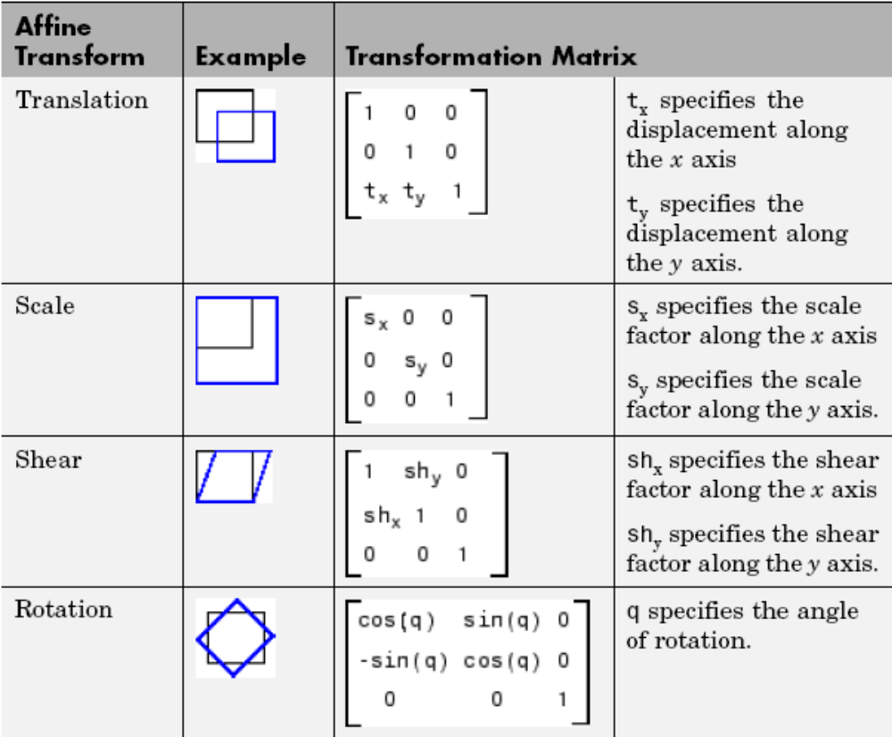
Using a Transformation Matrix

Slide 15
Using Sets of Points
To do this for an affine transformation, you must pick three non-collinear points in the input image and in the output image. (The points form a triangle.)
  in_points = [11 11;21 11; 21 21]
  out_points = [51 51;61 51;61 61]
  tform2 = maketform('affine', in_points , out_points)

Slide 16
**Presentation Assignment
Use Examples!
imresize
imrotate
imcrop
maketform
imtransform

Slide 17

**Presentation Assignment
Explain
This code uses imtransform to perform a projective transformation of a checkerboard image.
  I = checkerboard(20,1,1);
  figure; imshow(I)
  T = maketform('projective',[1 1; 41 1; 41 41; 1 41],...
  [5 5; 40 5; 35 30; -10 30]);
  R = makeresampler('cubic','circular');
  K = imtransform(I,T,R,'Size',[100 100],'XYScale',1);
  figure, imshow(K)

Slide 18
**Presentation Assignment
Explain
Exploring a Conformal Mapping
The demo includes these steps:
  Step 1: Warp an Image Using a Conformal Transformation
  Step 2: Explore the Mapping Using Grid Lines, Circles, and Images
  Step 3: Obtain a Special Effect by Masking Parts of the Output Image
  Step 4: Repeat the Effect on a Different Image

Slide 19
**Presentation Assignment
Explain
Padding and Shearing an Image Simultaneously
The demo includes these steps:
  Step 1: Transform an Image Using Pure Shear
  Step 2: Explore the Transformation
  Step 3: Compare the `fill', `replicate', and `bound' Pad Methods
  Step 4: Exercise the 'circular' and 'symmetric' Pad Methods

